Slide 1

Modern Mass Spectrometry-Based Platforms
Solving Complex Biological Question
Epigenetics and Cancer - Histone Modifications
Samples – Preparation – Separation – Mass Spec Analysis – Informatics – Reporting
Archive Presentation – November 2011
Basic Histone Epiproteomics Assays
Jeremiah D. Tipton, Ph.D.
Director and Applications Manager
Applied Omics & Life Sciences LLC
Agilent Technologies Applications Contractor
Presentation For Life Sciences Research Only, Not for Diagnostic Purposes

Slide 2
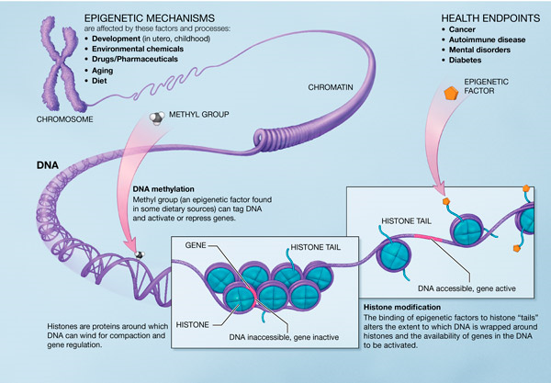
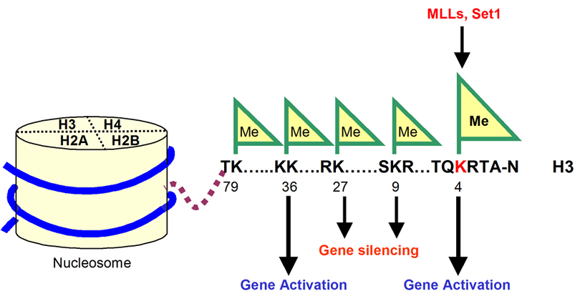
Epigenetics and Cancer - Histone Modifications
Histone Acetyl Transferase (HAT)
Histone Deacetylase (HDAC)
Histone Methyltransferase
Archive Original - November 29, 2011

Slide 3
Epigenetics and Cancer - Histone Modifications
(2011)
Type of Modification
H3K4
H3K9
H3K14
H3K27
H3K79
H3K20
H2BK5
Mono-methylation
activation
activation
activation
activation
activation
activation
Di-methylation
repression
repression
activation
Tri-methylation
activation
repression
repression
repression
repression
Acetylation
activation
activation
Archive Original - November 29, 2011
Notes:
→ The similarity of the word to "genetics" has generated many parallel usages. The "epigenome" is a parallel to the word "genome", and refers to the overall epigenetic state of a cell. The phrase "genetic code" has also been adapted—the "epigenetic code" has been used to describe the set of epigenetic features that create different phenotypes in different cells. Taken to its extreme, the "epigenetic code" could represent the total state of the cell, with the position of each molecule accounted for in an epigenomic map, a diagrammatic representation of the gene expression, DNA methylation and histone modification status of a particular genomic region. More typically, the term is used in reference to systematic efforts to measure specific, relevant forms of epigenetic information such as the histone code or DNA methylation patterns.
→ Describe Human Population
→ HDAC inhibitor acute myeloid chrmonic lymphocyte leukemia
→ Pathway deregulation affect Acetylation and methylation
→ only look at histone modifications
→

Slide 4
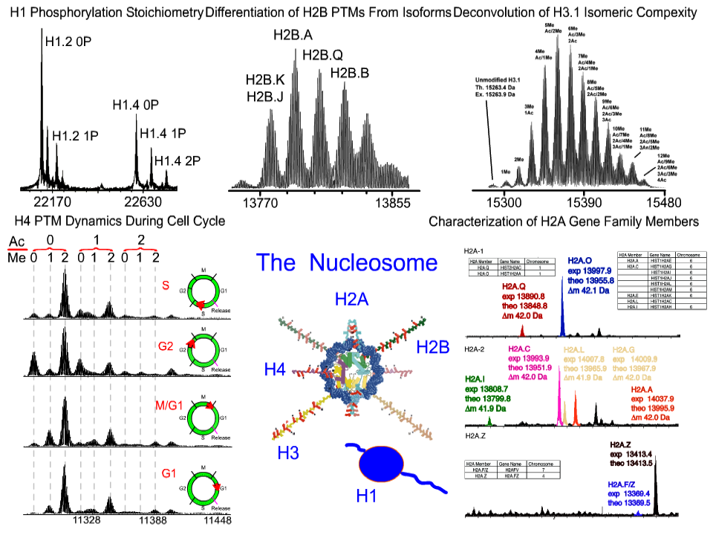
Epigenetics and Cancer - Histone Modifications
Archive Original - November 29, 2011

Slide 5
Histone LCMS - QqQ Assay - Basic Assay
(Me#)
(Ac)
(Me#)
(Me#)
(Ac)
(Ac)
(Me#)
4
9
14
18
27
36
56
79
ARTKQTARKSTGGKAPRKQLATKAARKSAPATGGVKKPHRYRPGTVALREIRRYQKSTELLIRKLPFQRLVREIAQDFKTDLRFQSSAVMALQEASEAYLVGLFEDTNLCAIHAKRVTIMPKDIQLARRIRGERA
Bottom up
Trypsin
Digestion
Other Common Strategies Developed – Glu C /Asp N/Arg C and chemical derivatization.
Archive Original - November 29, 2011

Slide 6
Histone LCMS - QqQ Assay - Basic Assay
(Me#)
(Ac)
(Me#)
(Me#)
(Ac)
(Ac)
(Me#)
4
9
14
18
27
36
56
79
ARTKQTARKSTGGKAPRKQLATKAARKSAPATGGVKKPHRYRPGTVALREIRRYQKSTELLIRKLPFQRLVREIAQDFKTDLRFQSSAVMALQEASEAYLVGLFEDTNLCAIHAKRVTIMPKDIQLARRIRGERA
1) Propionic anhydride
(propinyl amides)
2) Trypsin Digestion
Garcia, B.A. et. al. Chemical Derivatization of Histones for Facilitated Analysis by Mass Spectrometry. Nature Protocols, 2007. 2(4): p. 933-938.
K4 Peptide / K9 K14 Peptide / K18 Peptide / K27 K36 Peptide / K 56 Peptide / K79 Peptide
Archive Original - November 29, 2011

Slide 7
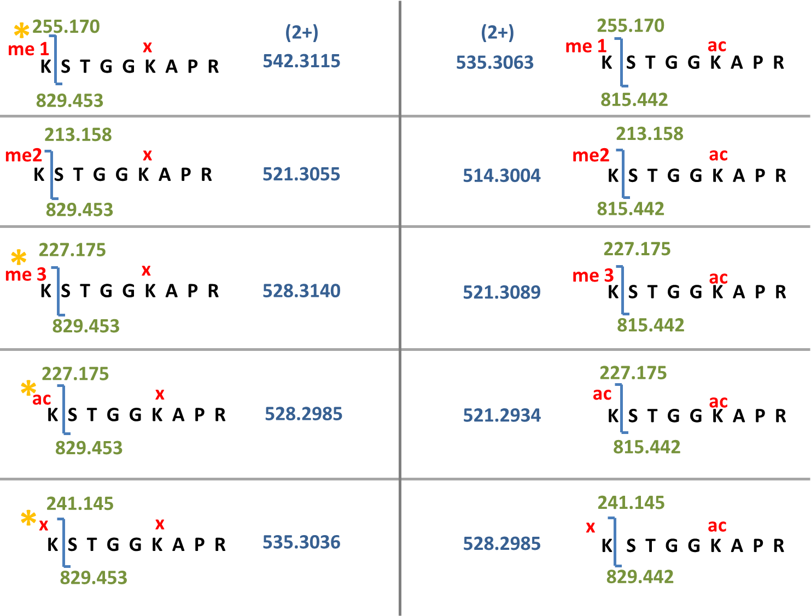
Histone LCMS - QqQ Assay - Basic Assay
Assay Development – “K9-K14” Peptide
Archive Original - November 29, 2011

Slide 8
Histone LCMS - QqQ Assay - Basic Assay
Assay Development – “K9-K14” Peptide
Add signal response for all K9/K14 peptides
(Response in the peak area)
Divide the individual peak area by the total area
(Result is the Percent Relative Occupancy )
Final Result is a ‘Digital Western Blot ‘
Archive Original - November 29, 2011

Slide 9
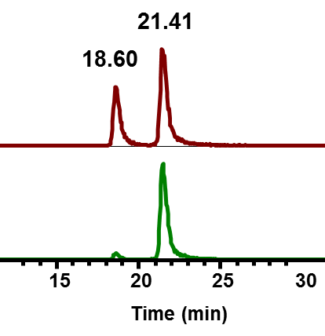
Histone LCMS - QqQ Assay - Basic Assay
K9 me3
528.3140 (+2)
Technical Note and Understanding
K9 ac
528.2985 (+2)
641 y₆
K9 me3
829 y₈
272 y₂
227 b₁
226.8
227.0
m/z
227.2
227.4
271.8
272.0
m/z
272.2
272.4
641.2
641.4
641.6
829.2
829.4
829.6
829.8
m/z
m/z
829 y₈
227 b₁
K9 ac
272 y₂
641 y₆
226.8
227.0
227.2
227.4
271.8
272.0
272.2
272.4
641.2
641.4
641.6
829.2
829.4
Archive Original - November 29, 2011
m/z
m/z
m/z
m/z
829.6
829.8

Slide 10
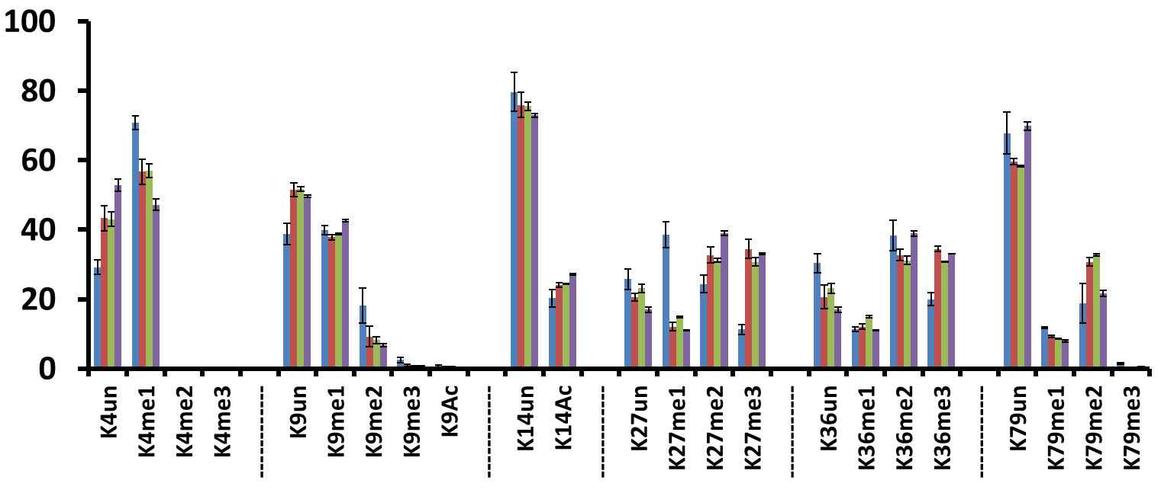
Histone LCMS - QqQ Assay - Basic Assay - Results
Digital Western Blot
CLL Samples
HeLa S3
Sample 1 (1)
Sample 1 (2)
Sample 2
Percent Relative Occupancy (% R.O.)
*
*
*
*
*
Methylation (and Acetylation) on Histone 3.(1,2,3)
Archive Original - November 29, 2011

Slide 11
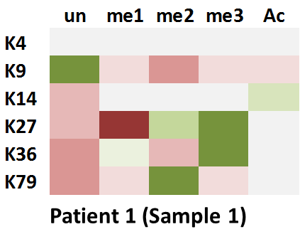
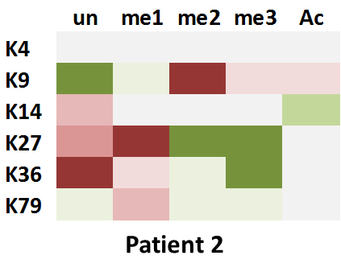
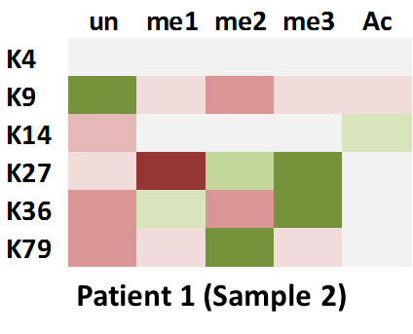
Histone LCMS - QqQ Assay - Basic Assay - Results
Reference for “Heat Map”
Patient Sample - HeLa S3
Data from Oncology Samples
Archive Original - November 29, 2011

Slide 12
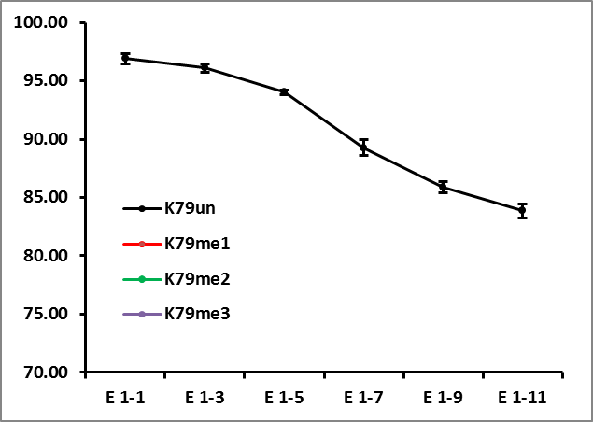
Histone LCMS - QqQ Assay - Basic Assay - Results
K79 peptide
Percent Relative Occupancy (% R.O.)
Decrease Inhibitor
Archive Original - November 29, 2011

Slide 13
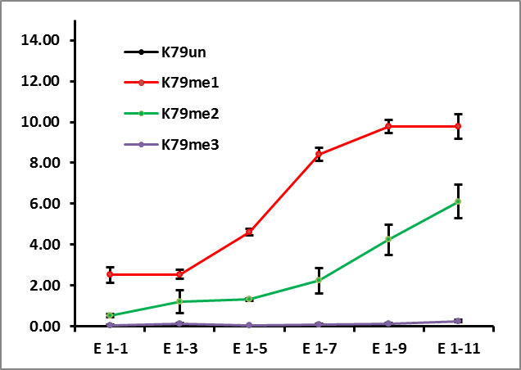
Histone LCMS - QqQ Assay - Basic Assay - Results
K79 peptide
Percent Relative Occupancy (% R.O.)
Decrease Inhibitor
Archive Original - November 29, 2011

Slide 14
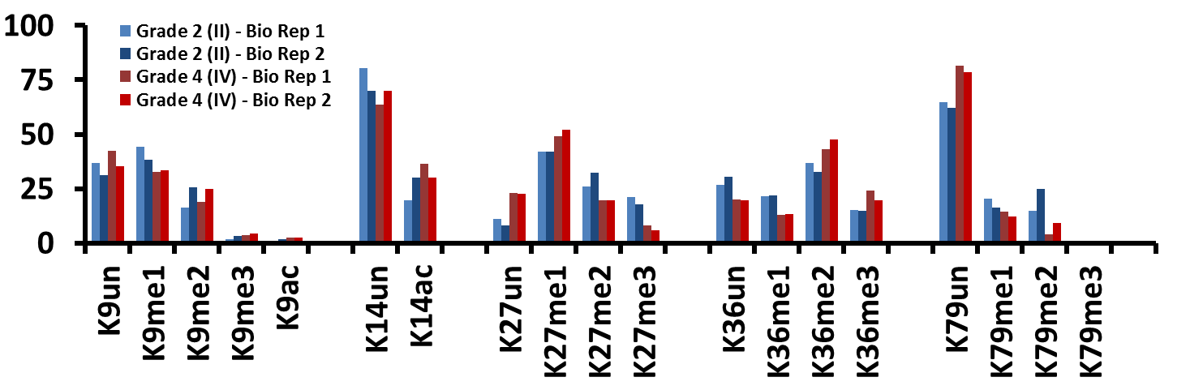
Histone LCMS - QqQ Assay - Basic Assay - Results
Oncology Samples
2-5 % Coefficient
of Variance Between
Technical Triplicates
Percent Relative Occupancy (% R.O.)
~ 5% Difference Between
Biological Reps
~ 10 - 15% Difference Between
Grade II and IV Cells
Archive Original - November 29, 2011

Slide 15
Epigenetics and Cancer - Histone Modifications
Samples – Preparation – Separation – Mass Spec Analysis – Informatics – Reporting
Archive Presentation – November 2011
Basic Histone Epiproteomics Assays
Histone LCMS - QqQ Assay - Basic Assay
Presentation For Life Sciences Research Only, Not for Diagnostic Purposes

